Slide 1
Project Overview
Redesign and Innovation
Team Name: Orange JuiCC
Team Members: Omena Aboagye, Claudia Aguilar, Jimmy Nguyen Challenge: iSchool Design Challenge
Notes:
Make a copy of this presentation and replace with your project name. You can add or take away slides as needed. Please be as creative as you feel like! This template is just meant to be a jump-off point so feel free to edit your slides however you choose!
Logo & color scheme can be changed to fit sponsor.

Slide 2
Table of Contents
Project Overview
Goals
Roles Assign
Research
Initial sketches/Low-fi prototype
High-fi prototype/Final concept
Further Considerations
Live demo
Redesign and Innovation
Team Name: Orange JuiCC
Team Members: Omena Aboagye, Claudia Aguilar, Jimmy Nguyen Challenge: iSchool Design Challenge
Notes:
Set the stage -- what steps did you take to work to a solution?

Slide 3

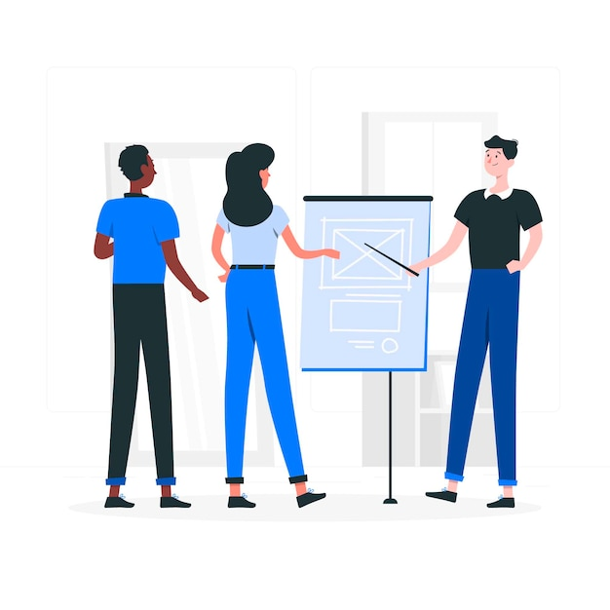

Project Overview
#1 Fastest Growing Undergraduate Program
Difficult for students to find information.
Solve the problem!
Notes:
This can be taken from the challenge document itself.

Slide 4
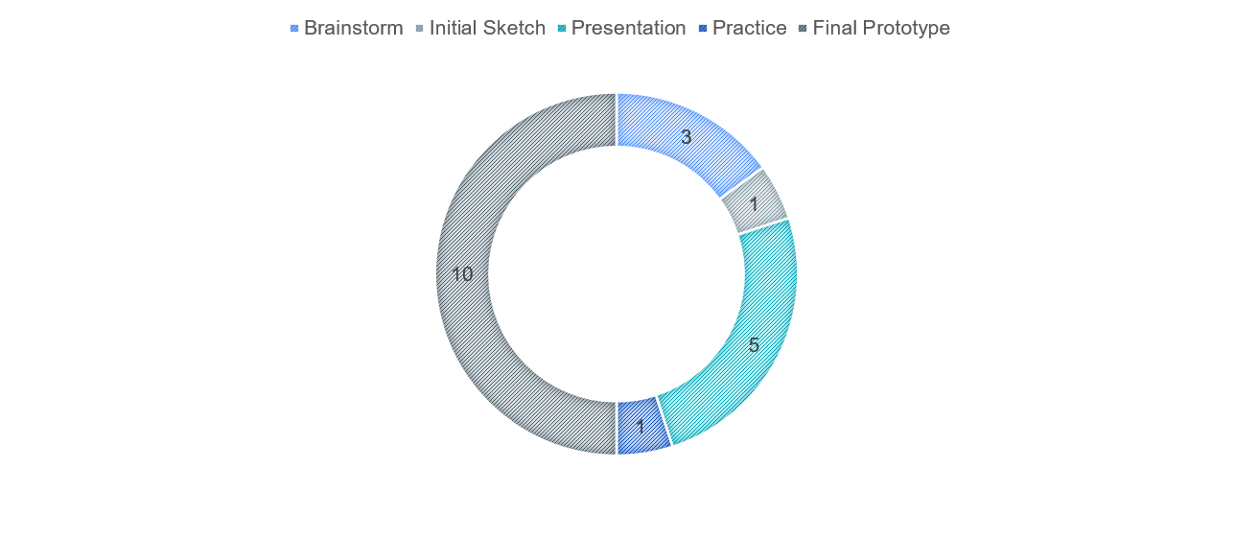
Goals
Notes:
This can be taken from the challenge document itself and edited to suit the goals you are trying to achieve with your solution.

Slide 5
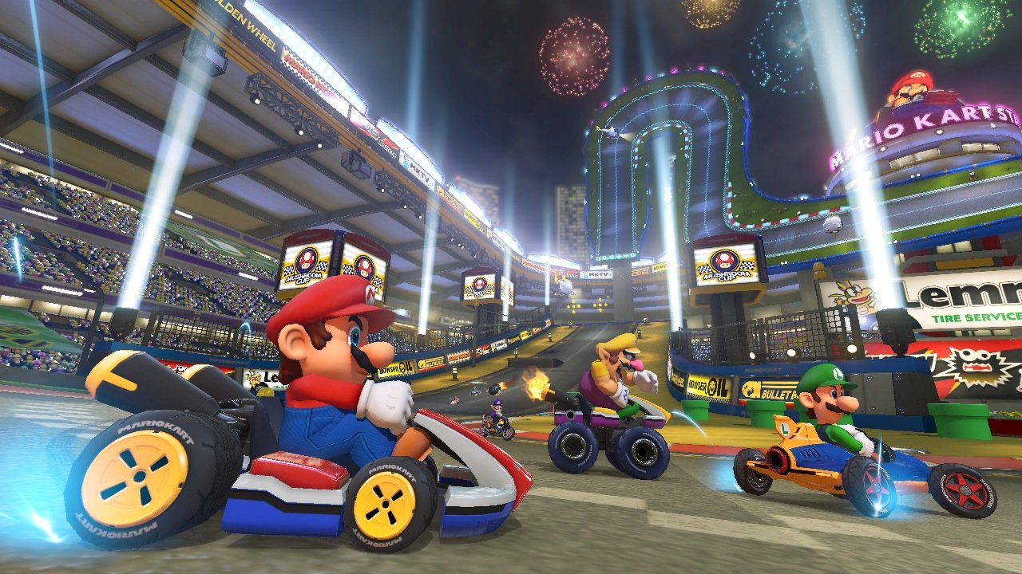



Tasks/Roles Assigned
Jimmy Omena Claudia
Researcher
Sketch Artist
Team Lead
Designer
Notes:
Every design project needs team members to take on specific tasks in order to complete the project effectively.
What role is each of you playing?
For example, sketch artist, coder, designer, researcher, team lead (if applicable), etc.

Slide 6
Research
Student Goals
Obtain a job role.
Searching for community.
What skills are good for workforce?
Complete major.
What type of job roles can I apply for my major?
What stuff should I be doing to be prepared for such role?
Are there a list of organizations that pertain to my major?
Is there a site that lists all organizations?
Notes:
What did you learn about the users?
What challenges did you identify?
What were the different themes or concepts you came up with?

Slide 7
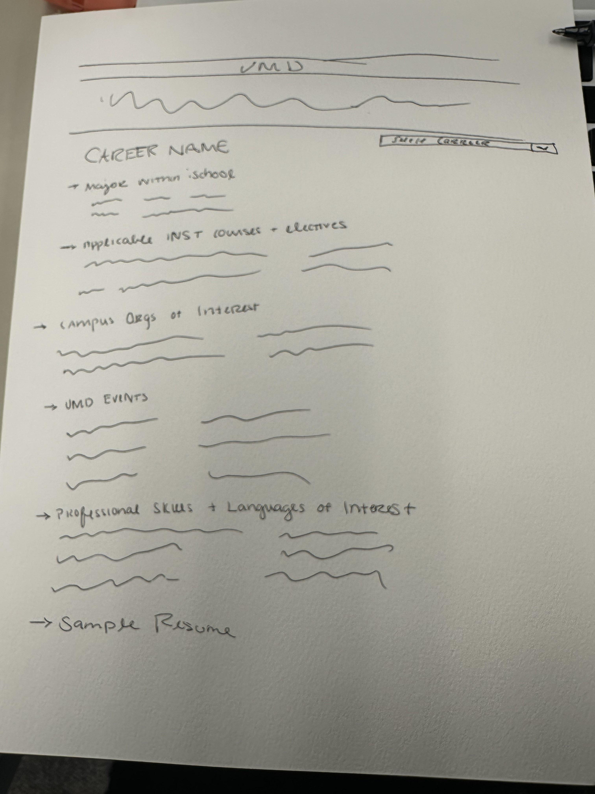
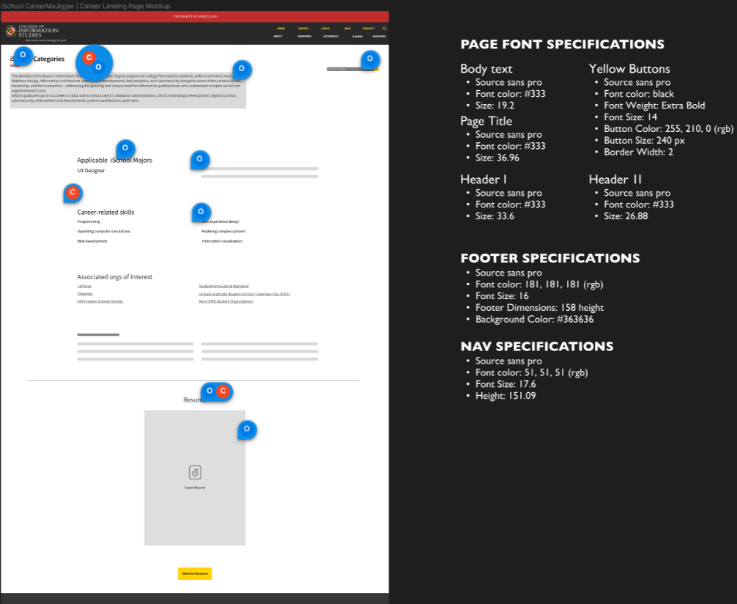
Initial Sketches/Low-Fi Prototypes
Notes:
Drawings, sketches, digital ideas, mock-ups

Slide 8
High-Fi Prototypes
Notes:
please delete/ignore this Slide if it does not apply to your final concept -- see resources below!
Free High-fi Prototyping Tools:
Proto.io (proto.io/)
Balsamiq (balsamiq.com/)
Figma (figma.com/)
Invision (invisionapp.com/)
Marvel (marvelapp.com/)
Any other tool you want to use
Free UI Kits:
Uplabs (uplabs.com/)
The Noun Project (thenounproject.com/)
Adobe XD UI Kits (adobe.com/products/xd/resources.html)

Slide 9


Further Considerations
Notes:
please delete/ignore this Slide if it does not apply to your final concept -- see resources below!
Free High-fi Prototyping Tools:
Proto.io (proto.io/)
Balsamiq (balsamiq.com/)
Figma (figma.com/)
Invision (invisionapp.com/)
Marvel (marvelapp.com/)
Any other tool you want to use
Free UI Kits:
Uplabs (uplabs.com/)
The Noun Project (thenounproject.com/)
Adobe XD UI Kits (adobe.com/products/xd/resources.html)

Slide 10
Live Demo
Notes:
Link to your prototype/concept/idea and show how it all ties together!

Slide 11
Thank You!
What questions do you have for us?
Notes:
Q&A

